Slide 1
Concentration Guided Dosing
TDM is Dead! Long Live TCI!
Nick Holford
MBChB, FRACP
Dept Pharmacology & Clinical Pharmacology
University of Auckland

Slide 2
Clinical Pharmacology
Pharmacokinetics
Pharmacodynamics
CL
V
Emax
C50
Dose
Concentration
Effect
Concentration Guided Dosing
Notes:
Clinical pharmacology describes the effects of drugs in humans. One way to think about the scope of clinical pharmacology is to understand the factors linking dose to effect.
Drug concentration is not as easily observable as doses and effects. It is believed to be the linking factor that explains the time course of effects after a drug dose.
The science linking dose and concentration is pharmacokinetics. The two main pharmacokinetic properties of a drug are clearance (CL) and volume of distribution (V).
The science linking concentration and effect is pharmacodynamics. The two main pharmacodynamic properties of a drug are the maximum effect (Emax) and the concentration producing 50% of the maximum effect (C50).
Effects do not determine the dose. The effect is determined by concentration. Concentration determines the dose needed for the effect. Thus concentration guided dosing provides the scientific basis for achieving the right dose.

Slide 3
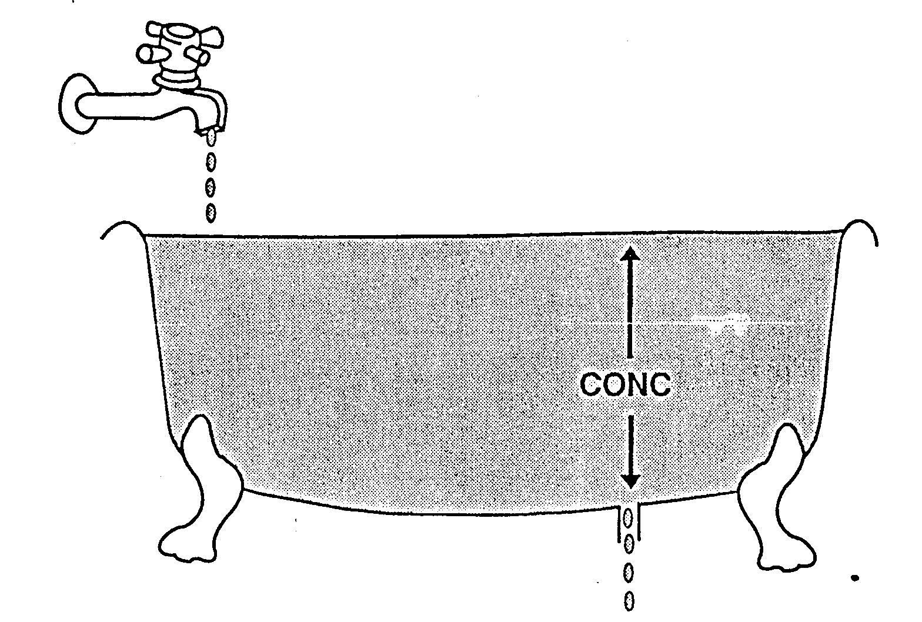


Clearance & Volume
$$CL=\frac{Rate Out}{Conc}$$
$$V=\frac{Amount}{Conc}$$
Notes:
http://clinpharmacol.fmhs.auckland.ac.nz/docs/clearance.pdf
The bathtub provides a physical model to explain how clearance determines drug elimination.
This bathtub has fixed rate of water flowing in from the tap (rate in = 4 drops/unit time).
Water is lost from the bathtub at the same rate (rate out = 4 drops/unit time) which keeps the bath water level constant (steady state).
Clearance is determined by the size of the hole in the bathtub.

Slide 4
Emax & C50
Emax
C₅₀
Notes:
http://clinpharmacol.fmhs.auckland.ac.nz/docs/immediate-time-course-of-drug-effect.pdf
http://clinpharmacol.fmhs.auckland.ac.nz/docs/ligand-binding.pdf
Based on the law of mass action principle the binding of a drug to a receptor should follow a hyperbolic curve (as shown here). If it is assumed that the effect is directly proportional to the binding then the C50 will be the same as the Kd (the equilibrium binding constant).
Notice that Emax can never be directly observed. It is the asymptotic effect of the drug at infinite concentration. Even 10 times the C50 only reaches 90% of Emax.

Slide 5
Target Concentration in Clinical Use of Medicines
Target Conc = Target Effect x C50 / (Emax -Target Effect)
Target Conc | Dose Model
Initial Peak | Loading Dose = Target Conc x Volume of distribution
Average Steady State | Maintenance Dose Rate = Target Conc x Clearance
Ideal dose prediction requires individual estimates of
Emax, C50, Volume and Clearance
Notes:
The target concentration approach links PKPD to prediction of the right dose for a patient.

Slide 6
Three Ways to Dose
Population
  Same dose for everyone
    The dream dosing method! (often used in adults)
Group (Covariate guided)
  Same dose for similar group
    e.g. same weight (usually used for children), CLcr, genotype
Individual
  Dose determined by individual response
    e.g. BP, INR, blood conc
Holford & Buclin 2012
Notes:
There are 3 ways to think about choosing the dose.
The population dosing method uses the same dose for everyone. It is the most commonly used method but usually just for convenience. This means that some patients are either under-dosed or over-dosed.
The group dosing method uses patient factors (also known as covariates) to predict the dose suitable for a group of patients with similar factors. Dosing in children is nearly always based on weight or age. The use of weight or renal function to adjust the dose is recommended for some medicines but probably not used as often as it should be.
Individual dosing based on patient response is widely used when the response is easily measured. For example anti-hypertensive doses are usually adjusted based on the blood pressure response. The use of other response markers such as the international normalized ratio (INR) response to warfarin or the concentration of an antibiotic such as gentamicin are also examples.
CLcr = Creatinine clearance, BP = Blood Pressure, INR=International Normalized Ratio
Holford NHG, Buclin TMD. Safe and effective variability - A criterion for dose individualization. Ther Drug Monit 2012; 34: 565-68.

Slide 7
Concentration Guided Dosing
Goal
Approach
Measurement
Method
Dose Calculation
Concentration Guided Dosing (CGD)
Therapeutic Drug Monitoring (TDM)
Target Concentration Intervention (TCI)
Therapeutic window
Target concentration
Response may mean drug concentrations or biomarkers e.g. INR, BP
Response
Compare measurement
with window criterion
Use measurement to
estimate clearance
Dose increase if low
Dose decrease if high
Maintenance dose rate =
Target concentration x clearance
Notes:
Concentration may mean the use of biomarkers e.g. INR, BP, with or without drug concentration measurements. Note samples may be adapted to the approach but the same measurements may be used with other approaches. BP is used as an example because it is a very widely used biomarker with individualized dosing using the seat of the pants method and dose calculation.
Goal means – what is the goal for the concentration e.g. average steady state conc, steady state AUC, steady state trough
Approach means – what is the criterion used to guide the dosing method e.g. therapeutic window, target concentration
Method means – what is the procedure used to implement the approach e.g. ‘seat of the pants’, model based [e.g. exact parameter (clearance =dose rate/Css), Bayesian parameter (EBE clearance)]
TW method illustrates ‘seat of the pants’ calculation but could include a model based calculation (possible but rare to find an example)
TC method illustrates a model based method where the goal is the average steady state concentration
Individual dose calculation means the algorithm used to propose an individual dose and dosing interval to achieve the goal
Dosing procedure means the control method used to determine the actual dose and dosing interval based on the proposed dose and dosing interval e.g. open control based on prescriber judgement (includes practical factors such as available tablet sizes), closed control using an infusion pump controller for infusion rate)

Slide 8

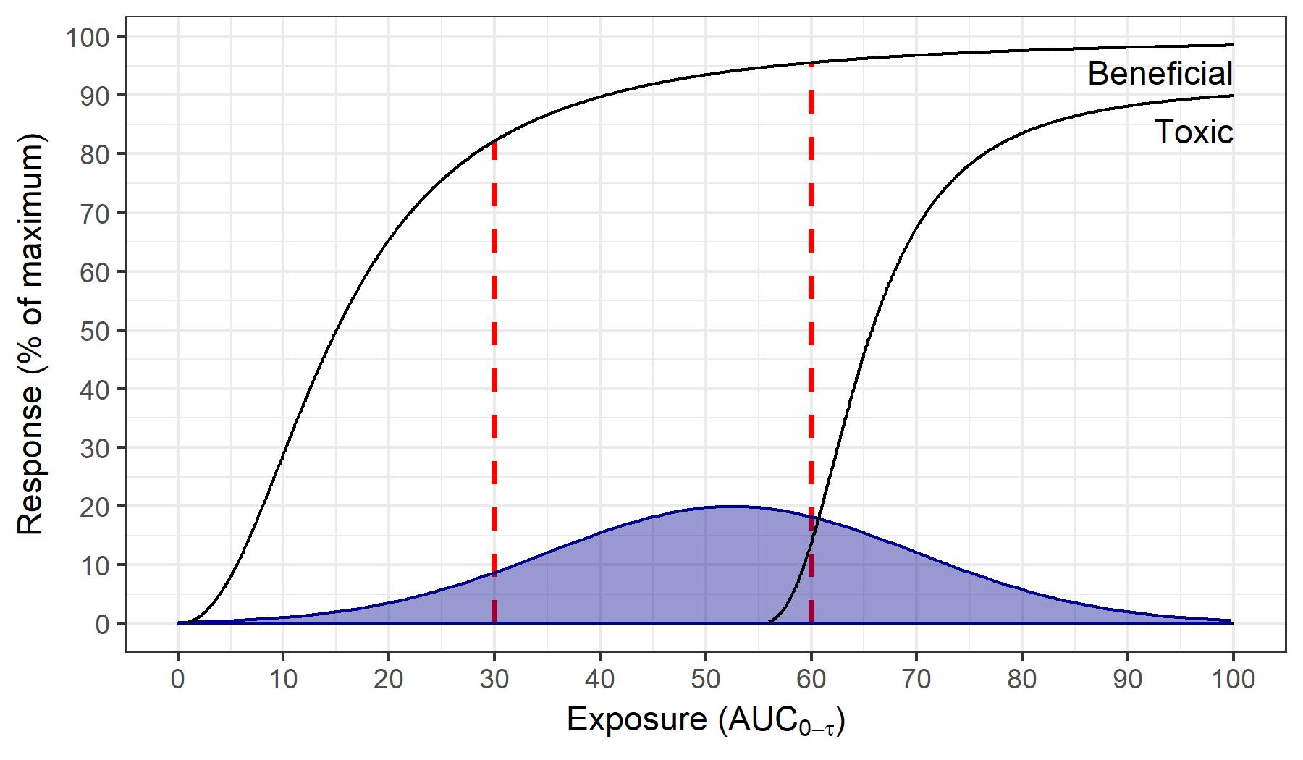





Therapeutic Drug Monitoring
Treatment failure
Serious toxicities
Outcome (%)
Response e.g. Css
Slide courtesy of David Metz, U of Melbourne
Notes:
In the clinic patients will have exposure within, at the limit of, and outside the acceptable range. They will be distributed within and across the therapeutic window.
The therapeutic drug monitoring approach, assumes, that all our patients sit within the flags. This assumption is not correct.

Slide 9
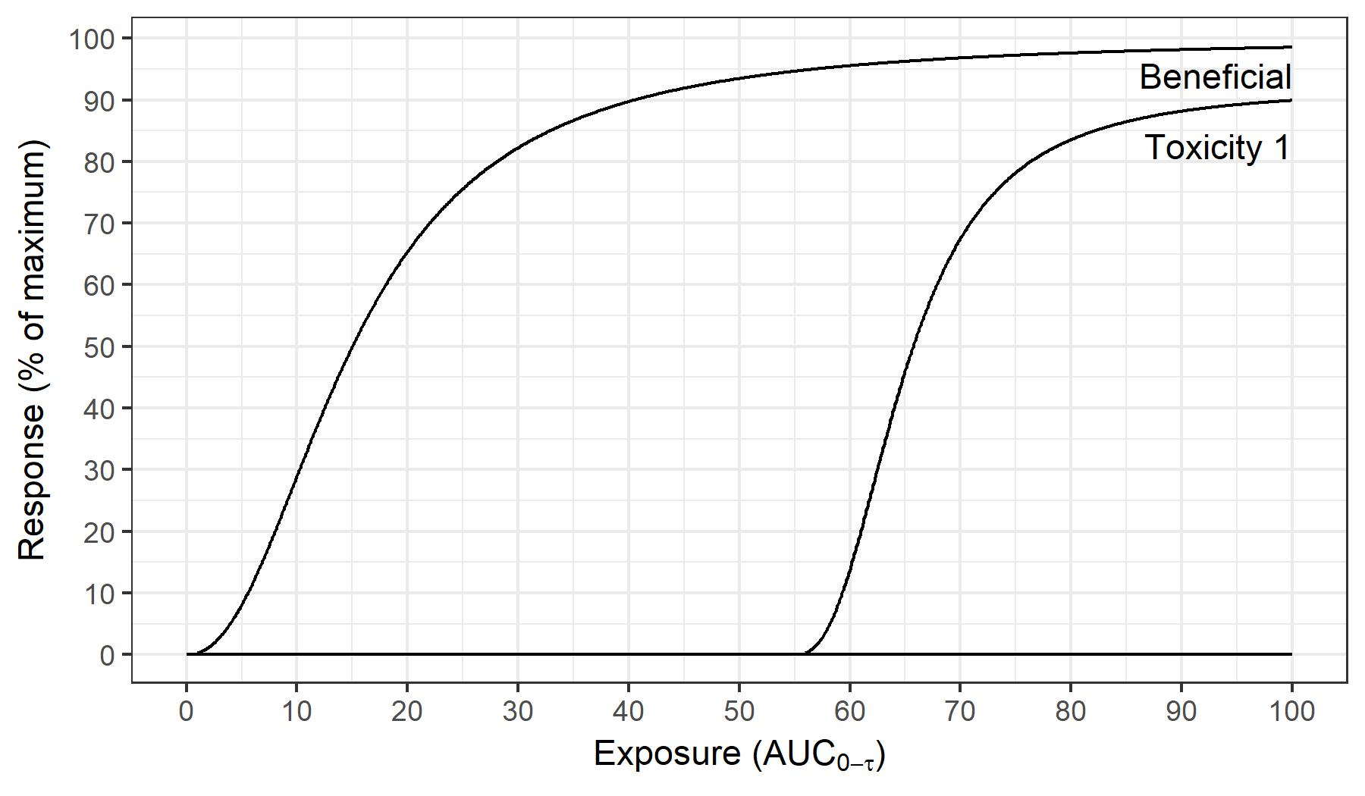
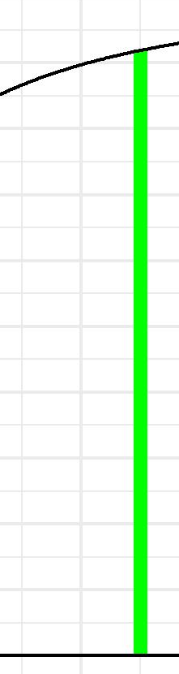
Target Concentration Intervention
Outcome (%)
Target Concentration
Response e.g. Css
Slide courtesy of David Metz, U of Melbourne
Notes:
We can be more accurate and precise if we remove the flags and aim for a specific target. In the target concentration intervention approach, every measurement is used to guide dose adjustment to achieve a target concentration a measure which is correlated with improved outcomes.
As described previously, maintenance dose rate is related to the target concentration and clearance. Therefore if we know the clearance for an individual, then the maintenance dose rate is known.
Target concentration intervention also provides a method to link target concentration with dose. This means that the clinician is provided a proposed dose that will achieve the target.

Slide 10
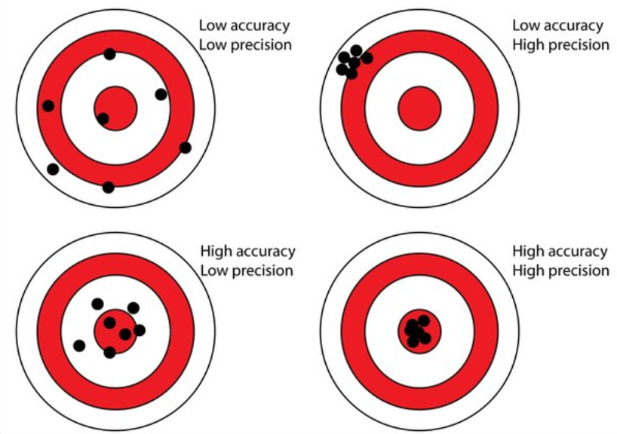
Accuracy and Precision
Notes:
Note the difference between precision and accuracy. It is possible to have group shots at a target so that they are close together and thus precise – but not at the centre of the target. An accurate group of shots will be centred on the target. The term “precision dosing’ is not the same as “accurate dosing”. That is why target concentration intervention is a better description of individualized dosing method than precision dosing.
Figure from: https://www.researchgate.net/publication/304674901_Digital_Close-Range_Photogrammetry_-_A_Modern_Method_to_Document_Forensic_Mass_Graves/figures?lo=1

Slide 11
TDM or TCI?
Toxic
Therapeutic Drug Monitoring
  TDM Therapeutic Window
  ☹
  Sub-optimal at borders of the window
Imprecise
Ineffective
Target Concentration Intervention
  TCI Single Target
  ☺
  Optimal – do the best you can
Accurate
Ideal !
Notes:
http://clinpharmacol.fmhs.auckland.ac.nz/docs/target-concentration-intervention.pdf
Note the difference between precision and accuracy. It is possible to have group shots at a target so that they are close together and thus precise – but not at the centre of the target. An accurate group of shots will be centred on the target. The term “precision dosing’ is not the same as “accurate dosing”. That is why target concentration intervention is a better description of individualized dosing method than precision dosing.

Slide 12
Why TDM Cannot Work
TDM proposes a range of concentrations to judge if an individual is getting the right dose
It is not reasonable to prescribe a range of doses in order to match the range of concentrations
Therefore the therapeutic window cannot be used to get the right dose
There is only one dose that can achieve the target concentration that will produce the target effect

Slide 13
TCI vs TDM - Tacrolimus
TDM
  Use of TDM had no effect in reducing renal transplant rejection
    Thervet (2010): Fixed dose vs Genotype dosing (increased fraction within therapeutic window)
    Anutrakulchai (2019): Fixed dose vs Genotype dosing (increased fraction within therapeutic window, more delayed graft function)
TDM = goal was to reach exposure within therapeutic range in every patient. Clinicians were given dosing advice.
Notes:
Anutrakulchai S, Pongskul C, Kritmetapak K, Limwattananon C, Vannaprasaht S. Therapeutic concentration achievement and allograft survival comparing usage of conventional tacrolimus doses and CYP3A5 genotype-guided doses in renal transplantation patients. Br J Clin Pharmacol. 2019;85(9):1964-73.
Thervet E, Loriot MA, Barbier S, Buchler M, Ficheux M, Choukroun G, et al. Optimization of initial tacrolimus dose using pharmacogenetic testing. Clin Pharmacol Ther. 2010;87(6):721-6.

Slide 14
TCI vs TDM - Vancomycin
3 published studies compared TCI with historical TDM
All showed TCI achieved more patients in the therapeutic window than TDM
All showed reduced nephrotoxicity with TCI
Confirmed in Auckland, NZ using NextDose
TCI = goal was to reach target AUC in every patient. Clinicians were given dosing advice using Bayesian estimation.
TDM = goal was to reach target trough within therapeutic window in every patient. Clinicians may have been given dosing advice (varied by study).
  Truong et al. Int Med J (2012), Neely et al. Antimicrob Agents Chemo (2018), Meng et al. Pharmacotherapy (2019)
Notes:
Meng L, Wong T, Huang S, Mui E, Nguyen V, Espinosa G, et al. Conversion from Vancomycin Trough Concentration–Guided Dosing to Area Under
the Curve–Guided Dosing Using Two Sample Measurements in Adults: Implementation at an Academic Medical Center. Pharmacotherapy: The Journal of Human Pharmacology and Drug Therapy. 2019;39(4):433-42.
Truong J, Levkovich BJ, Padiglione AA. Simple approach to improving vancomycin dosing in intensive care: a standardised loading dose results in earlier therapeutic levels. Internal Medicine Journal. 2012;42(1):23-9.
Neely MN, Kato L, Youn G, Kraler L, Bayard D, van Guilder M, et al. Prospective Trial on the Use of Trough Concentration versus Area under the Curve To Determine Therapeutic Vancomycin Dosing. Antimicrob Agents Chemother. 2018;62(2):e02042-17.

Slide 15
TCI vs TDM - Mycophenolate
TCI
  Use of TCI reduced renal transplant rejection
    Hale 1998 (Phase 3): Randomized Concentration Controlled Trial. 3 Target AUCs.
    Le Meur 2008 (APOMYGYRE): Fixed Dose vs Target AUC
TDM
  Use of TDM had no effect in reducing renal transplant rejection
    van Gelder 2008 (FDCC): Fixed dose vs Therapeutic Window AUC
    Gaston 2009 (OPTICEPT): Fixed dose vs Therapeutic Window Trough
TCI = goal was to reach target in every patient. Clinicians were given dosing advice using Bayesian estimation.
TDM = goal was to reach exposure within therapeutic range in every patient. Clinicians were not given dosing advice.
Notes:
Hale M, Nicholls A, Bullingham R, Hene R, Hoitsman A, Squifflet J, et al. The pharmacokinetic-pharmacodynamic relationship for mycophenolate mofetil in renal transplantation. Clin Pharmacol Ther. 1998;64:672-83.
Le Meur Y, Buchler M, Thierry A, Caillard S, Villemain F, Lavaud S, et al. Individualized mycophenolate mofetil dosing based on drug exposure significantly improves patient outcomes after renal transplantation. Am J Transplant. 2007;7(11):2496-503.
van Gelder T, Silva HT, de Fijter JW, Budde K, Kuypers D, Tyden G, et al. Comparing mycophenolate mofetil regimens for de novo renal transplant recipients: the fixed-dose concentration-controlled trial. Transplantation. 2008;86(8):1043-51.
Gaston RS, Kaplan B, Shah T, Cibrik D, Shaw LM, Angelis M, et al. Fixed- or controlled-dose mycophenolate mofetil with standard- or reduced-dose calcineurin inhibitors: the Opticept trial. Am J Transplant. 2009;9(7):1607-19.
Rousseau A, Laroche M-L, Venisse N, Loichot-Roselmac C, Turcant A, Hoizey G, et al. Cost-Effectiveness Analysis of Individualized Mycophenolate Mofetil Dosing in Kidney Transplant Patients in the APOMYGRE Trial. Transplantation. 2010;89(10):1255-62.

Slide 16
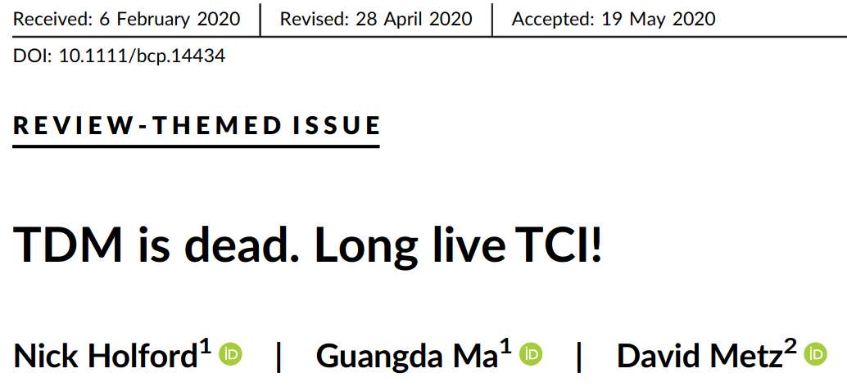
Conclusion
Holford et al Brit J Clin Pharmacol 2020
Notes:
Holford N, Ma G, Metz D. TDM is dead. Long live TCI! Br J Clin Pharmacol. 2020; Early View (doi:10.1111/bcp.14434).

Slide 17
Acknowledgements
Thanks to heads of department, my colleagues and students who have supported and shared this journey
Thanks to the University of Auckland for salary and computing resources

Slide 19
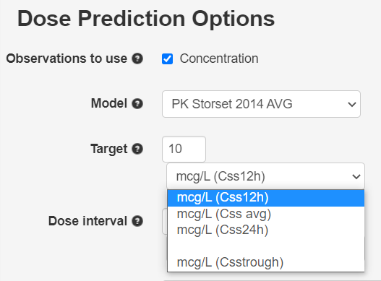
NextDose http://www.nextdose.org
Notes:
NextDose provides options for different target types e.g. here it shows targets based on Css, AUCssDI and cumAUC.

